Slide 1
CoE-R&WS
Welcome to
Presentation on
Web Enabled M.Tech (IITM)
Communication & Signal Processing
Nirbhay Kumar Singh
Deputy Manager
CoE-R&WS
2021-2024
Grade: 9.32
05th June 2025

Slide 2
Agenda
Introduction
Brief on M.Tech Course
Brief on M.Tech Project
Application in BEL Projects
Experience and Suggestions

Slide 3
Introduction
Course Type : Web Enabled M.Tech
Roll No : EE21M521
Institute Name : Indian Institute of Technology, Madras
Stream : Communication and Signal Processing
Start of M.Tech : Jan, 2022
Completion of M.Tech : May, 2024
Grade (CGPA) : 9.32

Slide 4
Brief on M.Tech Course
S.No | Course Number | Course Name | Trimester (period)
1 | EE6901W, EE6902W,EE6903W | Project: Phase 0, Phase 1 and Phase 2 | 5,6,7(May2023-May 2024)
2 | EE5179W | Deep learning for Imaging | 6 (Sept-Dec 2023)
3 | EE5142W | Introduction to Information Theory and Coding | 5 (May-Aug 2023)
4 | EE5311W | Digital IC Design | 5 (May-Aug 2023)
5 | EE5111W | Estimation Theory | 4 (Jan-Apr 2023)
6 | EE5130W | Digital Signal Processing | 3 (Sept-Dec 2022)
7 | EE5178W | Modern Computer Vision | 3 (Sept-Dec 2022)
8 | EE5140W | Digital Modulation and Coding | 2 (May-Aug 2022)
9 | EE5120W | Applied Linear Algebra I for EE | 2 (May-Aug 2022)
10 | EE5110W | Probability Foundations for Electrical Engineers | 1 (Jan-Apr 2022)
Overall CGPA: 9.32

Slide 5
Brief on M.Tech Project
Project Title: Target Detection and Classification using Deep Learning for Surveillance RADAR

Slide 6
Problem Statement : State of the Art
Presently available Solutions and their short comings
CFAR and Doppler's processing are used for target detection in most surveillance RADARs. CFAR based detection process relies on only two features, i.e., threshold calculated from power and doppler bins. The performance of this approach degrades in heterogeneous ground clutter scenarios [1].
Another present available solution for the target classification is based on target Radar cross section(RCS), velocity, positions are analyzed over time. However, it requires relatively long response times, such as in the order of seconds [2] to get meaningful features.
Use of discriminative machine learning for target detection and deep learning methods for target classification for surveillance RADAR in heterogeneous clutter scenario.
The complete work includes design of direct RF based digital transceiver hardware, data collection, data labeling, data transformation, feature selection, model training, and evaluation
Scope of work

Slide 7



Research and Development
1
2
3
4
5
HEADING
HEADING
HEADING
HEADING
HEADING
FPGA based Multi channel, ultra low phase noise digital transceiver design
Digital transceiver firmware design and implementation
Synchronization of n-channel digital transceiver
Target detection using Machine learning
Target classification using deep learning algorithms.

Slide 8
Research and Development
Ultra low phase noise transmitter design
FPGA
Radar Waveform(LFM) parameters
Multi-channel Direct RF transmitter
Beam broadening
IQ data
Radar Controller(RC)
And Display
1G
Transmitting and receiving Antenna systems
Target With doppler and micro-doppler
10G ethernet
Multi-channel Direct RF sampling Receiver
1G
Target Detection
DPC, Pulse integration
Digital beam forming
IQ data
Signal processor with Centroider
Classification
Target detection
Micro doppler extraction

Slide 9
Direct Sampling Digital transceiver

Slide 10
Synchronization of n-channel digital transceiver

Slide 11
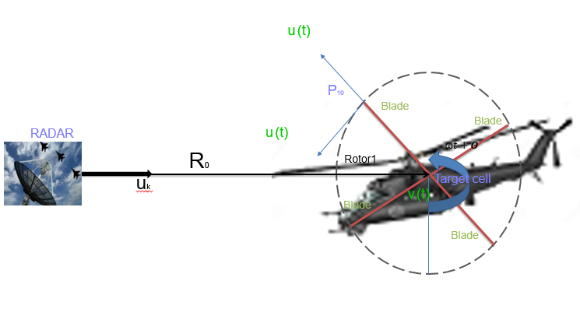
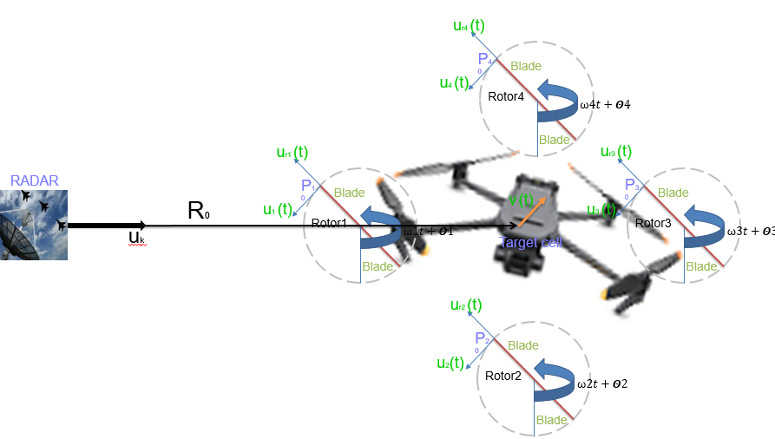
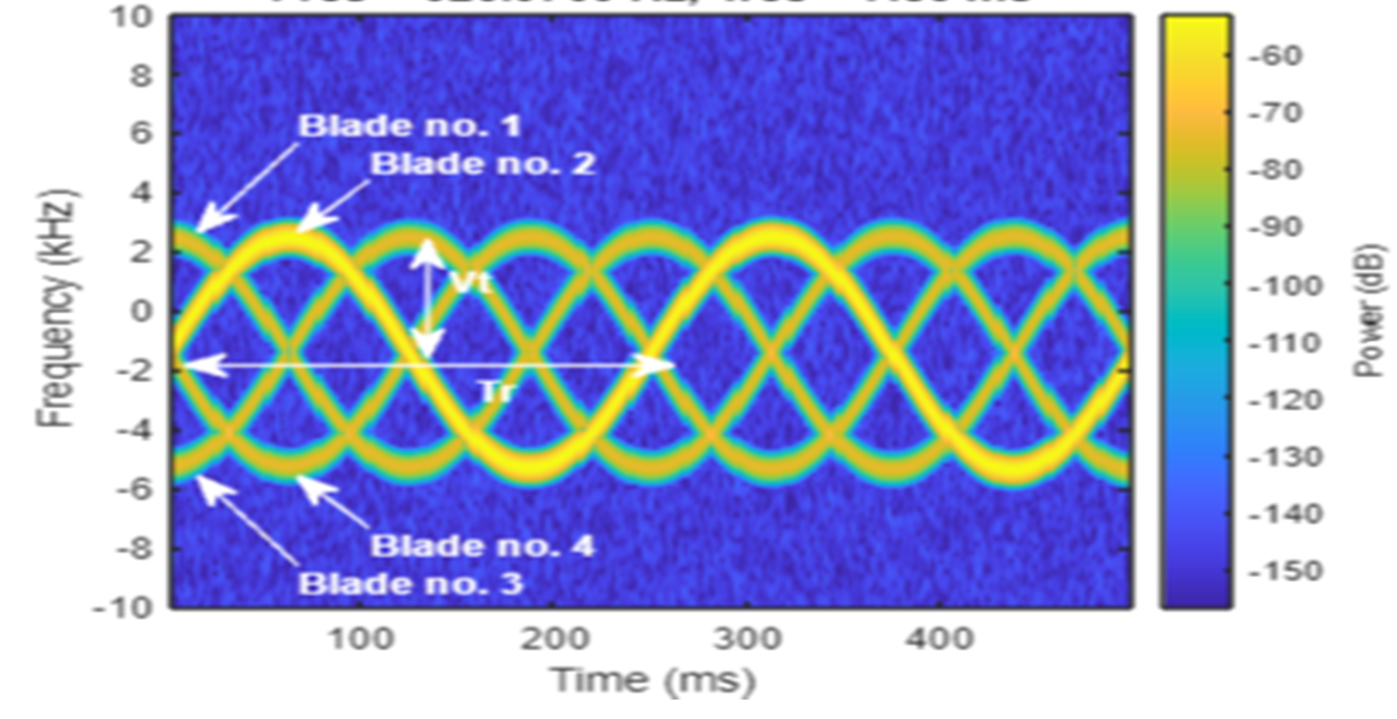
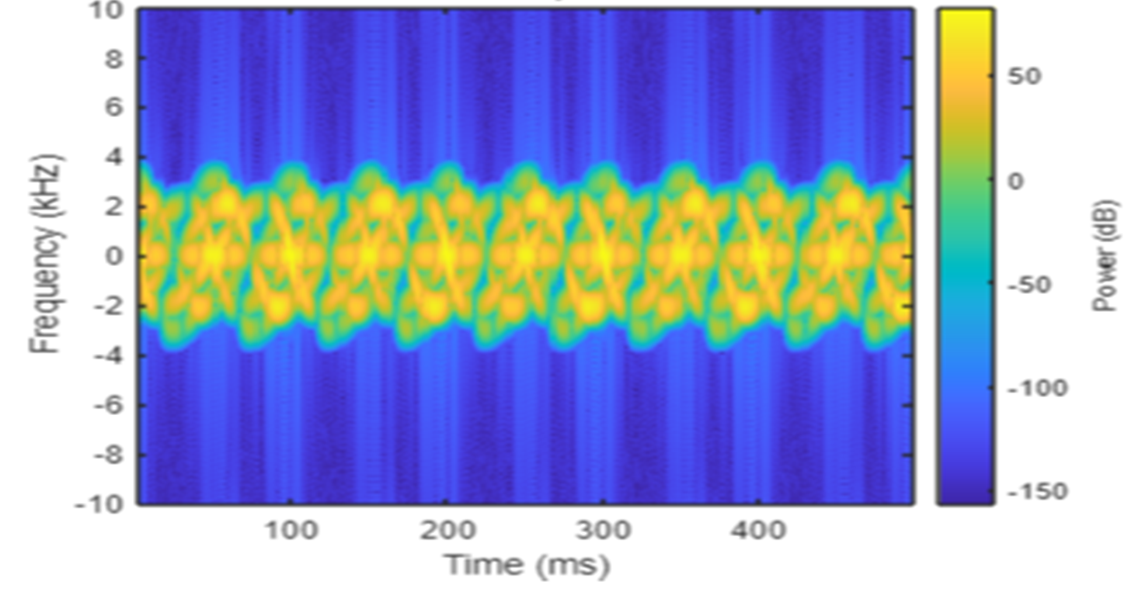
Test setup of Hovering helicopters and Drone

Slide 12
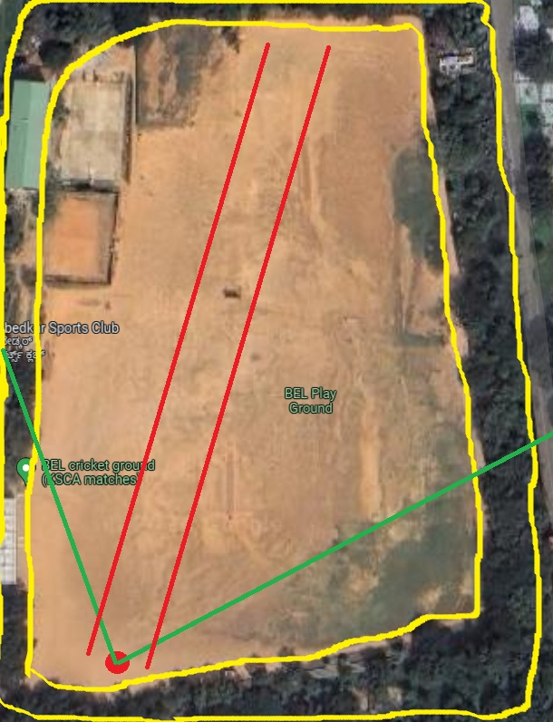
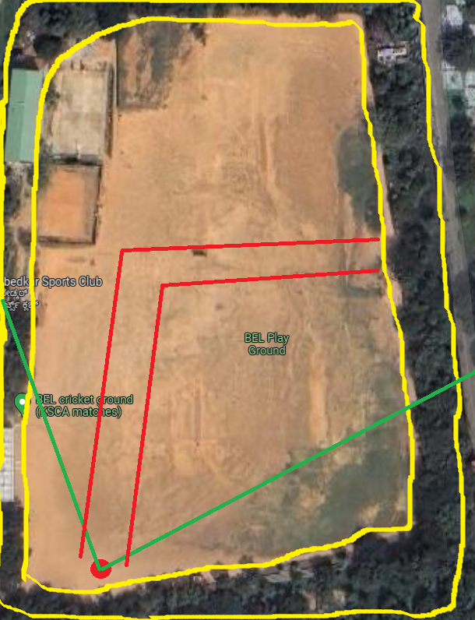
Data collection: collection sites
Data collection strategy 1: radial
Data collection strategy 2: Tangential

Slide 13
Target Detection: Machine learning models
Decision Tree(DT)
Support Vector Machine(SVM)
Artificial neural Network(ANN)
Target Classification: Deep learning models
Convolutional neural network(CNN)
Convolutional neural network-Long Short-Term Memory neural network(CNN-LSTN)

Slide 14
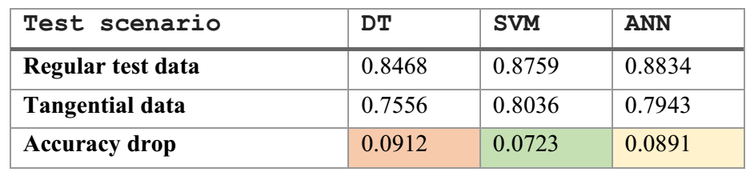
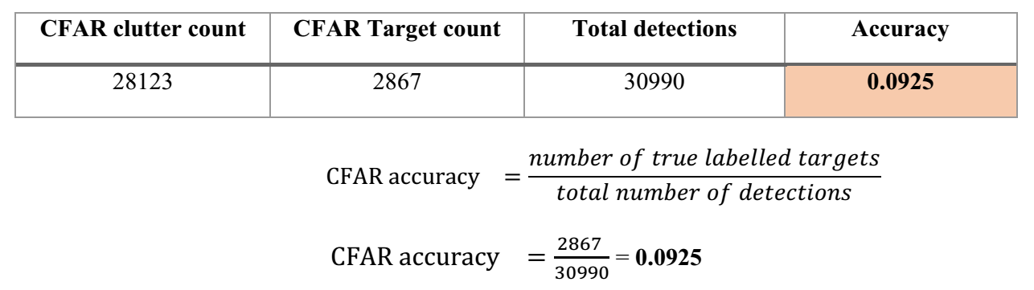
Results
S.No | Model | Train Accuracy | Test Accuracy
1 | CNN | 0.9156 | 0.8724
2 | CNN-LSTN | 0.9779 | 0.9257

Slide 15
Application in BEL Projects
Digital TRC – SASTRA ( Next generation Active phase array RADAR )
Design of Direct Sampling based 16 channels transceiver
Multi chip synchronization - 4 Chips
Multi board Synchronization – 168 Boards
Adaptive waveform generation
Digital beam forming
Planned
Target detection using ML
Target classification in DT mode using DL

Slide 16
Application in BEL Projects
Patents and papers
Patent titled “A method and system of synchronization of n-channel direct RF, digital transceiver with high-speed serial JESD204” .Application no. 202341083757 · Filed Dec 8, 2023 by Nirbhay Kumar Singh
Patent titled “Efficient and Scalable Multi-Channel Direct RF Digital Beamforming system” by Nirbhay Kumar Singh, Karthikeyan P, Shaik Abdul Subhan, Seema
IEEE Paper titled ,“Multi-Board Synchronization of n-Channel Direct RF Digital Transceiver for Active Phased Array Radar Using JESD204 Interface”. IEEE 9th International conference for convergence in technology Pune, 5th to 7th April 2024 by Nirbhay Kumar Singh .
IEEE Paper titled ,“Phase Noise Effects on Micro-Doppler Extraction for Radar Target Classification using Machine Learning”. IEEE APMC2024 in BALI, Indonesia by Nirbhay Kumar Singh, Malwinder Singh, Shaik Abdul Subhan , Seema.
Paper titled, “Target Detection and Classification Using Deep Learning for Surveillance RADAR”. CRL 2024 by Nirbhay Kumar Singh, Malwinder Singh, Shaik Abdul Subhan.

Slide 17
Experience and Suggestions
Experience
Emphasizing Skill Development and Application
Directly apply theoretical knowledge and cutting-edge research
Highlighting Time Management, Discipline, and Commitment
Suggestions
Guest Lecture on advance topic by IITM professors
More visit to IITM during courses and project

Slide 18
Thank You

